Slide 1
HUAWEI HiHealth Kit
For a Wholesome Digital Life

Slide 2
1. Service overview
2. HiHealth 4.0 architecture
3. Scenarios
3.1 Scenario 1: Java APIs based on the HUAWEI Health app
3.1.1 Open data items
3.1.2 User authorization method
3.1.3 Application method
3.2 Scenario 2: Cloud APIs based on HUAWEI Health App and HUAWEI Health Cloud
3.2.1 Open data items
3.2.2 User authorization method
3.2.3 Application method
3.3 Scenario 3: HiHealth HMS Kit（Health Kit） based on HMS Core
3.3.1 Open data items
3.3.2 User authorization method
3.3.3 Application method
4. Data flow diagram and security design
5. Global rollout
6. Google benchmarking and roadmap
7. FAQ
8. Codelab

Slide 3
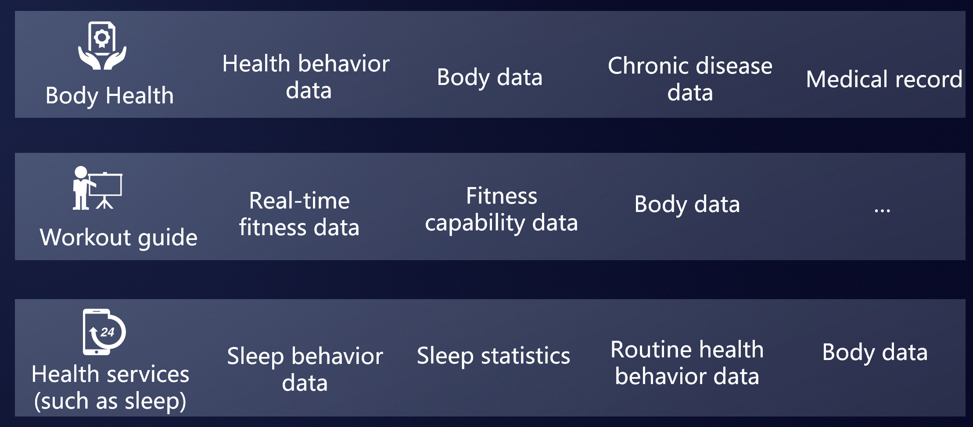
1. Service overview
Digital health requirements across various industries
How to obtain data?
Recent, continuous, and multi-dimensional data records
How to store data?
Secure and reliable data repository with various data types
Notes:
需求引入，HiHealth平台解决什么样的需求
一定要写目录、提纲。

Slide 4


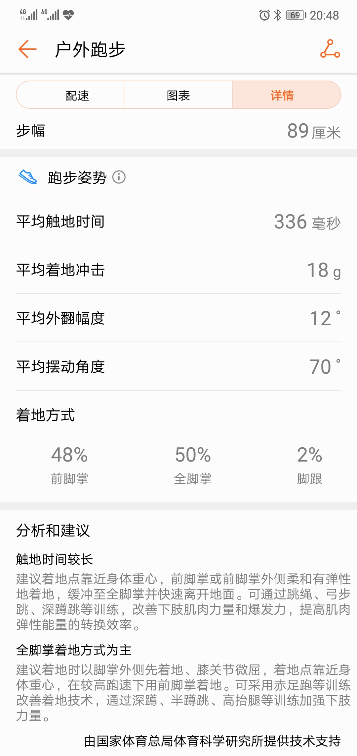

1. Service overview
Huawei solution: HiHealth
An open platform for fitness and health industry.
running
service
Devices collect data
HiHealth stores data
APPs ask for data
HiHealth opens data
Users
Devices
APPs
data
data
Huawei HiHealth

Slide 5







1. Service overview
HUAWEI HiHealth platform:
Enables developers and enterprises to do more with fitness and health data
Application
Service
Exercise
Guidance
Health
Insurance
Professional
Health Services
Family Care
…
Sports Service
Health Service
(Basic sports tools)
(Presentation, screening, and suggestion)
Sports & Health
HUAWEI HiHealth
All-Scenario
Terminal Device
Notes:
HiHealth 用一个具体的实例串起来。
先讲特点没有感觉，这些特点体现在哪里。

Slide 6

1. Service overview
HUAWEI HiHealth Kit:
Enables developers and enterprises to use the HiHealth platform more easily
…
Insurance
Fitness
Medical care
Education
Independent app
+
H5 service
+
Applet
+
Cloud service
…
Java APIs
Cloud APIs

Slide 7
1. Service overview
2. HiHealth 4.0 architecture
3. Scenarios
3.1 Scenario 1: Java APIs based on the HUAWEI Health app
3.1.1 Open data items
3.1.2 User authorization method
3.1.3 Application method
3.2 Scenario 2: Cloud APIs based on HUAWEI Health App and HUAWEI Health Cloud
3.2.1 Open data items
3.2.2 User authorization method
3.2.3 Application method
3.3 Scenario 3: HiHealth HMS Kit（Health Kit） based on HMS core
3.3.1 Open data items
3.3.2 User authorization method
3.3.3 Application method
4. Data flow diagram and security design
5. Global rollout
6. Google benchmarking and roadmap
7. FAQ
8. Codelab

Slide 8
2. HiHealth 4.0 architecture
Huawei Health APP based
HiHealth HMS Kit
Ecosystem APP
Health Industry
Ecosystem APP
Cloud services
HiHealth
HiHealth Kit
HiHealth HMS Kit = Health Kit
HiHealth API
Java API
Cloud API
Java API
Cloud API
Huawei Health App
HUAWEI Health Cloud
HiHealth HMS core
Health HMS Cloud
HiHealth core
Devices
Ecosystem partners
Sensors
Huawei Smart Wearables
Sport Devices
Health Devices
Step sensor in Smart Phone
Heart rate Sensor in Heart rate zone
*In China, we provide another API, JavaScript API, to help H5 services join in Huawei Health APP.

Slide 9
1. Service overview
2. HiHealth 4.0 architecture
3. Scenarios
3.1 Scenario 1: Java APIs based on the HUAWEI Health app
3.1.1 Open data items
3.1.2 User authorization method
3.1.3 Application method
3.2 Scenario 2: Cloud APIs based on HUAWEI Health App and HUAWEI Health Cloud
3.2.1 Open data items
3.2.2 User authorization method
3.2.3 Application method
3.3 Scenario 3: HiHealth HMS Kit（Health Kit） based on HMS Core
3.3.1 Open data items
3.3.2 User authorization method
3.3.3 Application method
4. Data flow diagram and security design
5. Global rollout
6. Google benchmarking and roadmap
7. FAQ
8. Codelab

Slide 10

3.1 Scenario 1: Java APIs based on the HUAWEI Health app
Scenario 1: Java APIs based on the HUAWEI Health app
Java APIs
Open data from HUAWEI Health app
Scenario-based data opening-up, based on data item combinations calculated by HUAWEI professional algorithms.
TruSleep: algorithm for sleeping data
TruSeen: algorithm for heart rate data
TrueRlex: algorithm for pressure data
About three scenarios: personal information, fitness data, and health data
Support from HUAWEI
HUAWEI HiHealth Kit provides the SDK for quick and convenient integration.
The SDK contains user authorization, reducing development workload.

Slide 11
3.1 Scenario 1: Java APIs based on the HUAWEI Health app
Authorization process of a Java API
User
Third-party app
(with Kit integration)
HUAWEI HiHealth platform
Initially install the app and open it
Request system permissions
Ask for the permission from the user to access the HUAWEI HiHealth platform
Confirm authorization
Request data permissions (data types that require authorization)
Show an authorization screen to request read/write permissions from the user
Select data types to be opened
Locally encrypt and store authorization information
Call the related kit API to read or write data
Query the LPT authorization information
Return user data or written result

Slide 12
3.1 Scenario 1: Java APIs based on the HUAWEI Health app
Open data items (app-based Java APIs)
Category | Sub-category | 3.2.1 Open data items | READ | WRITE
Personal information | Profile | One switch: gender, age, height, and weight | Y | N
Fitness data | Physical activity level | Four switches: step count, distance, calories, and medium high strength | Y | N
 | Walk/Run/Cycle | One switch: record data of a single workout Date, distance, duration, calories burnt, average pace, average speed, average step frequency, stride length, step count, average heart rate, cumulative climb, cumulative decline GPS data is not opened. | Y | N
Health data | Heart rate | One switch for regular heart rate statistics (daily, monthly, weekly, and yearly): heart rate range and resting heart rate One switch for real-time heart rate measurement: real-time heart rate and RR intervals (RRI) | Y | N
 | Blood glucose (sugar) level | One switch: date, time segment (before/after breakfast, before/after lunch, before/after dinner, before bedtime, and wee hours), and blood sugar value | Y | Y
 | Blood pressure | One switch: date, time, (high) systolic pressure, (low) diastolic pressure, and pulse | Y | Y
 | Weight | One switch: weight measurement, BMI, fat rate, muscle mass, basic metabolic rate, moisture rate, visceral fat level, bone salt, protein, body age, body type, and skeletal muscle mass | Y | Y
 | Sleep | One switch: earliest time to sleep, latest time to sleep, sleep score, light sleep duration, deep sleep duration, REM duration, deep sleep continuity score, night sleep duration (deep sleep duration + light sleep duration + REM duration), total sleep duration (night sleep duration + naps), and awake times | Y | N

Slide 13
4. Application process
Apply for a Java API (app-based)
Apply for a HUAWEI ID
Apply for a whitelist;
Sign the contract and agreement
Apply for an AppID and scope permissions
Wait for approval
App release
Joint commissioning and verification
App development with Kit integrated
*Prerequisites:
1. Huawei HiHealth_Kit needs to be integrated (China: V2.0.1.000 or later; Global: V2.0.1.300 or later).
2. The latest version of the HUAWEI Health app has been installed.
3. The phone must be a Huawei phone running EMUI 4.0 or later.
Note: This API is available only to enterprise developers at present.
For more cooperation information, please visit the Huawei Developer website and contact the email: hihealth@huawei.com.
Notes:
熊超负责流程对接

Slide 14
1. Service overview
2. HiHealth 4.0 architecture
3. Scenarios
3.1 Scenario 1: Java APIs based on the HUAWEI Health app
3.1.1 Open data items
3.1.2 User authorization method
3.1.3 Application method
3.2 Scenario 2: Cloud APIs based on HUAWEI Health App and HUAWEI Health Cloud
3.2.1 Open data items
3.2.2 User authorization method
3.2.3 Application method
3.3 Scenario 3: HiHealth HMS Kit（Health Kit） based on HMS core
3.3.1 Open data items
3.3.2 User authorization method
3.3.3 Application method
4. Data flow diagram and security design
5. Global rollout
6. Google benchmarking and roadmap
7. FAQ
8. Codelab

Slide 15


3.2 Scenario 2: Cloud APIs based on HUAWEI Health App and HUAWEI Health Cloud
Scenario 2: Cloud APIs based on Huawei Health Cloud and APP
Huawei Health
Cloud
Vitality
Cloud
Cloud APIs
Open data from HUAWEI Health app
Scenario-based data opening-up, based on data item combinations calculated by HUAWEI professional algorithms.
TruSeen: algorithm for heart rate data
For two scenarios: personal information and workout records
Phone
Huawei Health APP
Discovery
APP
Data
Service
Wear or use
Device

Slide 16
3.2 Scenario 2: Cloud APIs based on HUAWEI Health App and HUAWEI Health Cloud
Open data items (App-based Cloud APIs)
Open APIs
Cloud API | Description
API for infrastructure capability openness
huawei.oauth2.user.getTokenInfo | Query the token information, such as the openid of a user.
APIs related to fitness data
getSportsStat | Query daily exercise data summary of a user.
getMotionPathData | Query the workout trajectory.
API related to user and device info
getDeviceInfo | Query the information of a linked device.
API related to operation and activity info
joinActivity | Join an activity.
sendPushMessage | Send push messages.
Open data items
Cloud API | Description
Step count | Daily step count statistics, including the number of steps, calories burnt, and distance.
Data of a single workout | Summary and details of a single workout. contains Date, distance, duration, calories burnt, average pace, average speed, average step frequency, stride length, step count, average heart rate, cumulative climb, cumulative decline GPS data is not opened.
Device data | Basic information about the device the user has linked.

Slide 17
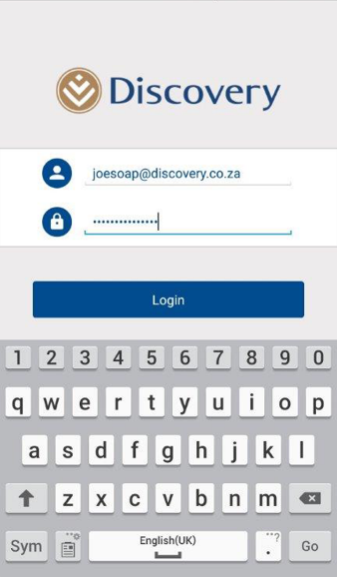
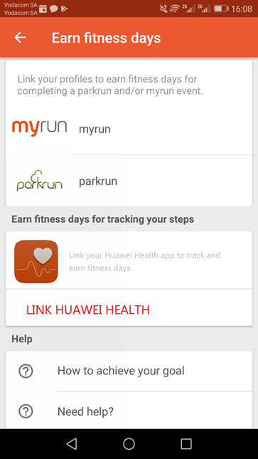
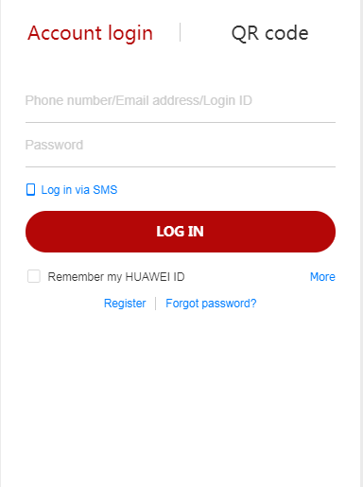
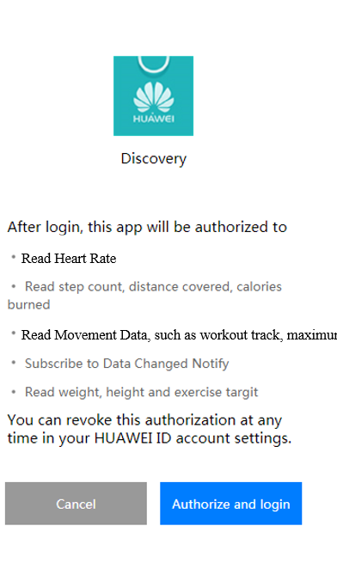
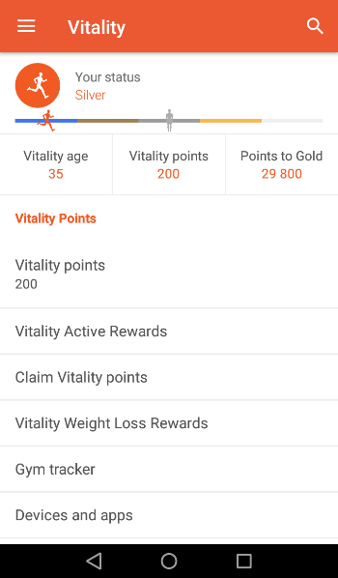
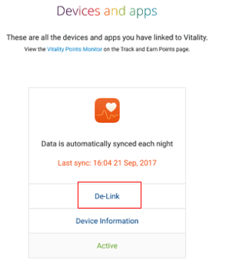
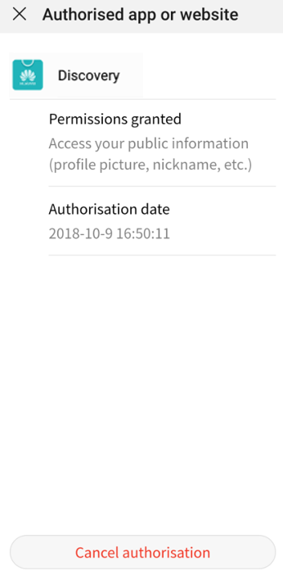
3.2 Scenario 2: Cloud APIs based on HUAWEI Health App and HUAWEI Health Cloud
Cloud-based authorization in HiHealth Kit Cloud API
1. Login Discovery's App
2. Select Huawei Health App
3. Authorized in Discovery’s App
4. Login Huawei ID in Discovery’s
5. View data in Discovery’s App
6. Withdraw in Discovery app or Huawei ID App

Slide 18
4. Application process
Apply for Cloud APIs ( to connect with HUAWEI Health Cloud)
Apply for an HUAWEI ID
Apply for a web app whitelist
Apply for an AppID and data access permission
Submit service access materials using the template
Official release on the live network
Wait for approval
Submit materials for release approval
Joint commissioning and verification
Develop
Note: This API is available only to enterprise developers at present.
For more cooperation information, please visit the Huawei Developer website and contact the email: hihealth@huawei.com.

Slide 19
1. Service overview
2. HiHealth 4.0 architecture
3. Scenarios
3.1 Scenario 1: Java APIs based on the HUAWEI Health app
3.1.1 Open data items
3.1.2 User authorization method
3.1.3 Application method
3.2 Scenario 2: Cloud APIs based on HUAWEI Health App and HUAWEI Health Cloud
3.2.1 Open data items
3.2.2 User authorization method
3.2.3 Application method
3.3 Scenario 3: HiHealth HMS Kit（Health Kit） based on HMS Core
3.3.1 Open data items
3.3.2 User authorization method
3.3.3 Application method
4. Data flow diagram and security design
5. Global rollout
6. Google benchmarking and roadmap
7. FAQ
8. Codelab

Slide 20

3.3 Scenario 3: HiHealth HMS Kit based on HMS Core
Scenario (HiHealth HMS Kit based on HMS Core)
Provides Cloud APIs and Java APIs, as well as SDKs for Java APIs.
Atomized data open: split the fitness and health scenario data and open it by item,. acquisition on demand.
Three types of data are opened: personal information, fitness data, and health data.
Provides Java APIs (including SDKs) for APP development scenarios
Provides the Restful API for 2 Cloud scenarios: web server and APP
3 ^{rd}
APP
Cloud
Serve
User
Use
Data R&W
HiHealth Kit in HMS core
(HiHealth 4.0 new add)
Store data
Device

Slide 21
3.3 Scenario 3: HiHealth Kit based on HMS Core
Open data items (HiHealth HMS Kit )
Public data:
Provide 3 permission scopes for each data item:
Access body height and weight in HUAWEI HiHealth Kit
Add body height and weight to HUAWEI HiHealth Kit
Access and Add body height and weight in HUAWEI HiHealth Kit
Restricted data:
Provide Read, but Write is controlled by Huawei, the 3rd party must apply Write from Huawei for the device.
Index | Category | Data Items
1 | Personal Information | Body height and weight
2 | Personal Information | Fitness goals
3 | Fitness data | Workout index data
4 | Fitness data | Step count
5 | Fitness data | Distance and floor change
6 | Fitness data | Speed
7 | Fitness data | Calories (include BMR)
8 | Fitness data | Pulmonary function (such as Maximum oxygen uptake)
9 | Fitness data | Medium high strength
10 | Fitness data | Activity data (such as activity samples, exercise, power, running posture, cycling pedaling, active minutes)
11 | Fitness data | Location data (include trajectory)
12 | Health data | Body fat (such as body fat percentage, BMI, muscle mass, water percentage, visceral fat level, bone salt, protein percentage, skeletal muscle mass)
13 | Health data | Sleep data
14 | Health data | Heart rate data
15 | Health data | Stress
16 | Health data | Relax training data
17 | Health data | Nutrition and hydration
Index | Category | Data Items
18 | Restricted data | Heart health data (such as HRV, ECG)
19 | Restricted data | Blood glucose
20 | Restricted data | Blood pressure
21 | Restricted data | Oxygen saturation
22 | Restricted data | Body temperature
23 | Restricted data | Reproductive data

Slide 22
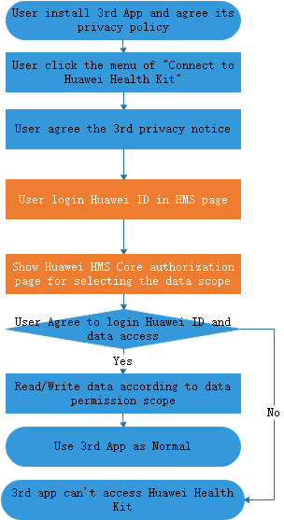
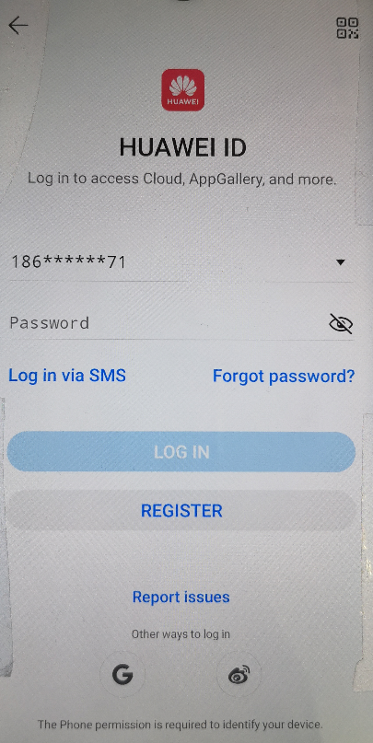
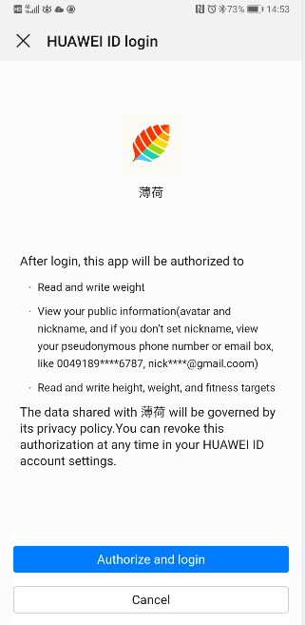


3.3 Scenario 3: HiHealth HMS Kit based on HMS Core
Health Kit in HMS authorization(relay on HMS Account Kit）
User authorization in 3rd Apps
Health Kit entry in 3rd app
Login and authorize Huawei ID in 3rd app
Discovery Vitality
This app will be authorized to
Associate you with your HUAWEI ID account
Add body height and weight to HUAWEI Health Kit
Access step count in HUAWEI Health Kit
Access and add heart rate data in HUAWEI Health Kit
Information you share with Discovery Vitality is subject to their privacy policy. You can revoke this authorization at any time in the HUAWEI ID Privacy center.
Select all items
Connect to Huawei Health Kit
Allow Vitality to access your height and weight, step count and heart rate in Huawei Health Kit to provide you more services.
(Display Privacy notice of 3rd app for user)
Cancel Connect
Connect to Huawei Health Kit

Slide 23

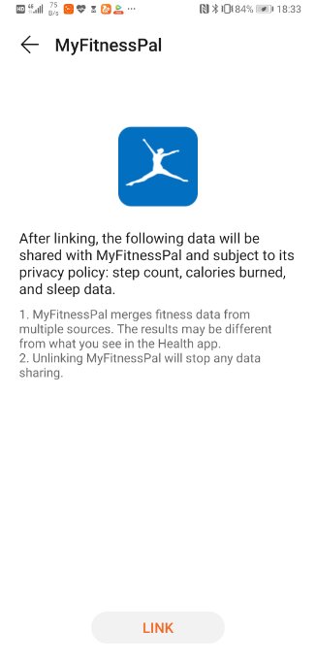



3.1 Scenario 1: Java APIs based on the HUAWEI Health app
revoke the Authorization in HUAWEI Health App
Entry page
Connect page
disconnect page
1. Manage authorization:
The user can manage the authorization by going to Me > Setting > Data sharing > Health Kit.
2. Authorize:
Touch Link to connect to and write data to Health Kit.
3. Cancel the authorization:
Users can cancel the authorization of the Health app writing by touching UNLINK.
4. Delete cloud data:
Users clear all data from both Health Kit cloud at any time by touching the Clear Data button.
After linking, your personal information, fitness data and health data in this app will be synced and uploaded to HUAWEI Health Kit Cloud.
Health kit enables you to manage and share your data across different health and fitness services. The data you shared will be available to third party apps only after you explicit authorization for each app.
You can clear the uploaded data or cancel this authorization at any time.
After unlinking, your personal information, fitness data and health data in this app will no longer be synced and uploaded to HUAWEI Health Kit Cloud. The uploaded data will remain available for authorized third party apps to access, unless you clear the data before unlinking.
Health Kit
Fitness data platform for access across services
Unlink by default
Notes
All data uploaded to HUAWEI Health Kit from the app will be erased and no longer be accessed from other services. Your data in this app will not be impacted.
CANCEL CONTINUE
Disabled if no shared data
Touch AGREE to upload your personal information, fitness data and health data to HUAWEI Health Kit cloud. You can clear the uploaded data or cancel this authorization at any time from this page.
DISAGREE AGREE
Enabled if shared data existed
Clear data
Clear data
LINK
UNLINK

Slide 24
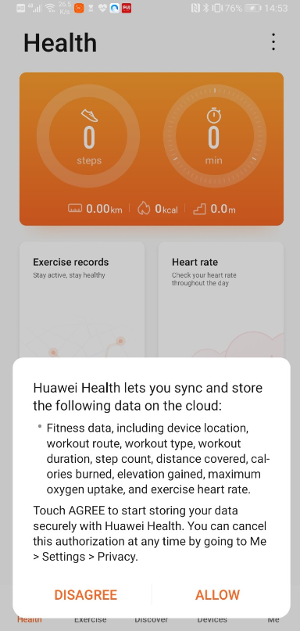
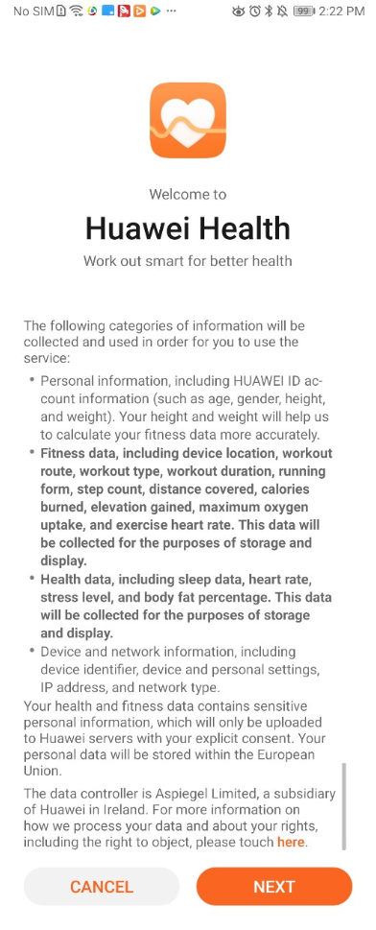

3.1 Scenario 1: Java APIs based on the HUAWEI Health app
Privacy Statement for the HUAWEI Health App
1. Health App Privacy Notice:
When the user opens the health app and authorizes the new privacy statement.
2. Uploading data authorization:
Pop up three existing upload consent and one more authorization page for writing data to health kit.
3. Manage the authorization:
User can check and manage the authorization at any time by going to Me > Setting > Data sharing > Health Kit.
Authorize HUAWEI Health App agreement and statement
Pop up existing upload consent and one more Health Kit authorization page
Check the authorization status
NO CHANGE. Let’s not confuse user. I will explain more in Health Statement
Do you want to upload your personal information, fitness data and health data to HUAWEI Health Kit cloud?
Health kit enables you to manage and share your data across different health and fitness services. When uploaded, the data will be available to third party apps only after you explicit authorization for each app.
Touch AGREE to upload the data to Health Kit. You can cancel this authorization or clear the data at any time by going to Me > Settings > Data sharing > Health Kit.
Health Kit
Manage your data across different services
Unlink by default

Slide 25
4. Application process
Apply for a Java API in HiHealth HMS Kit (Health Kit )
Apply for an HUAWEI ID
申请应用白名单
Apply for an AppID and scope permissions
Waiting for review
Apply for a whitelist;
Sign the contract and agreement
App release
Development
Joint commissioning and verification
App development with Kit integrated
*Prerequisites:
1. The Health Kit SDK (4.0.0.330 or later, subject to final release) has been integrated.
2. The Account Kit SDK (4.0.0.2) has been integrated.
3. The Huawei Mobile Services (APK) 4.0.0.50 or later has been installed.
4. The phone is running EMUI 5.0 or later.
Note: For more cooperation information, please visit the Huawei Developer website, and contact hihealth@huawei.com.
Notes:
熊超负责流程对接

Slide 26
4. Application process
Apply for a Cloud API in HiHealth HMS Kit(Health Kit)
Apply for an HUAWEI ID
Apply for a web app whitelist
Apply for an AppID and data access permission
Submit service access materials using the template
Official release on the live network
Waiting for review
Submit materials for release approval
Joint Commissioning and Verification
Development
*Prerequisites:
1. The Health Kit SDK (4.0.0.330 or later, subject to final release) has been integrated.
3. The Huawei Mobile Services (APK) 4.0.0.50 or later has been installed.
4. The phone is running EMUI 5.0 or later.
Note: For more cooperation information, please visit the Huawei Developer website, and contact hihealth@huawei.com.

Slide 27
1. Service overview
2. HiHealth 4.0 architecture
3. Scenarios
3.1 Scenario 1: Java APIs based on the HUAWEI Health app
3.1.1 Open data items
3.1.2 User authorization method
3.1.3 Application method
3.2 Scenario 2: Cloud APIs based on HUAWEI Health App and HUAWEI Health Cloud
3.2.1 Open data items
3.2.2 User authorization method
3.2.3 Application method
3.3 Scenario 3: Health Kit based on HMS Core
3.3.1 Open data items
3.3.2 User authorization method
3.3.3 Application method
4. Data flow diagram and security design
5. Global rollout
6. Google benchmarking and roadmap
7. FAQ
8. Codelab

Slide 28
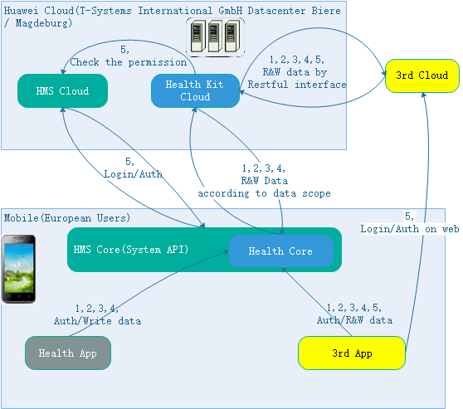
5. Data flow diagram and security design
Data flow diagram for HiHealth HMS Kit(Health Kit)
R/W Data in 3rd Apps:
Personal Information, including Body height and weight, Fitness goals, Workout index data.
Fitness data, including Step count, Distance and floor change, Speed, Calories (include BMR), Pulmonary function (such as Maximum oxygen uptake), Medium high strength, Activity data (such as activity samples, exercise, power, running posture, cycling pedaling, active minutes), Location data (include trajectory).
Health data, including Body fat (such as body fat percentage, BMI, muscle mass, water percentage, visceral fat level, bone salt, protein percentage, skeletal muscle mass), Sleep data, Heart rate data, Stress, Relax training data, Nutrition and hydration.
Restricted data, including Heart health data (such as HRV, ECG), Blood glucose, Blood pressure, Oxygen saturation, Body temperature, Reproductive data.:
Data permission Scope via Huawei Id:
Authorization data, including OpenId, Access Token
Health Kit Cloud:
Provide fitness data platform for ecosystem Apps, support data copy, Encrypted data by AES CBC 128 with different secret key for each user.
Health Core:
Provide local SDK for 3rd App integration to access the fitness data. All data is storage in sandbox of App and protected as A and B protection class by EMUI system.

Slide 29
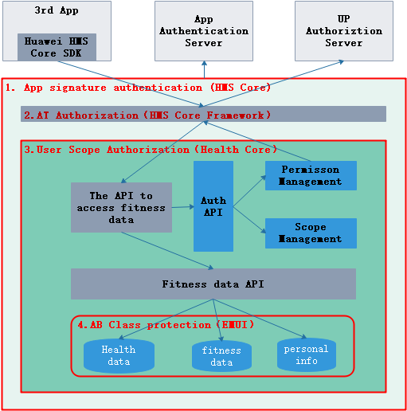
5. Data flow diagram and security design
Security Design HiHealth HMS Kit(Health Kit)
Server:
Access through at + scope authentication
Verify the three-party package name of the data source uploaded by the SDK,
Encrypt the data with the user level secret key on the cloud side.
Client:
Four levels of data protection:
Signature verification: three party app access needs to pass signature verification, and only applications registered by the development alliance can be accessed.
At authentication: the three-party app can only obtain at and access the data read-write interface of the health kit after the user logs in.
Scope authentication: the data read-write interface can read and write the corresponding type of user data only through the permission scope verification authorized by the user.
Class AB data protection: the data is saved in the application sandbox. The data under the lock screen can only be written and cannot be read, so as to prevent the user's data from leaking in the background. Technically, through the system hardware level file encryption protection, the motion data lock screen cannot be opened, and the health data lock screen cannot be read or written 10 seconds later.

Slide 30
1. Service overview
2. HiHealth 4.0 architecture
3. Scenarios
3.1 Scenario 1: Java APIs based on the HUAWEI Health app
3.1.1 Open data items
3.1.2 User authorization method
3.1.3 Application method
3.2 Scenario 2: Cloud APIs based on HUAWEI Health App and HUAWEI Health Cloud
3.2.1 Open data items
3.2.2 User authorization method
3.2.3 Application method
3.3 Scenario 3: Health Kit based on HMS Core
3.3.1 Open data items
3.3.2 User authorization method
3.3.3 Application method
4. Data flow diagram and security design
5. Global rollout
6. Google benchmarking and roadmap
7. FAQ
8. Codelab

Slide 31
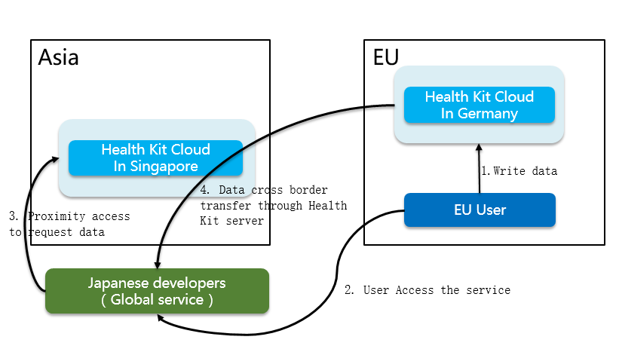

6. Global rollout
Cross-Border Data Transfer – HiHealth HMS Kit( Health Kit)
Japanese developer may ask EU user’s data, Huawei HiHealth Kit server in Singapore may transfer EU user’s data from HiHealth Kit Cloud in Germany to 3rd developers’ server in Japan
Servers deployed in Germany, Singapore, and Beijing to covering Europe, Asia, Africa, Latin America, and China.
Europe (Germany)
China (Beijing)
Europe
(Berlin)
Asia Africa Latin America (Singapore)
Summary:
The Huawei Health Kit cloud services are provided in the countries which Huawei Health already supported, the servers are deployed in Beijing, Germany, and Singapore respectively.
Cross-border data transfer among the data centers is not supported.
4 key countries:
Saudi Arabia and United Arab Emirates: The Health Kit can be rolled out, but the data of the HUAWEI Health app cannot be obtained.
Russia: Authorization must be manually signed. Currently, such authorization is not supported.
India: Local data protection laws require local server deployment, which is not supported currently.

Slide 32
1. Service overview
2. HiHealth 4.0 architecture
3. Scenarios
3.1 Scenario 1: Java APIs based on the HUAWEI Health app
3.1.1 Open data items
3.1.2 User authorization method
3.1.3 Application method
3.2 Scenario 2: Cloud APIs based on HUAWEI Health App and HUAWEI Health Cloud
3.2.1 Open data items
3.2.2 User authorization method
3.2.3 Application method
3.3 Scenario 3: Health Kit based on HMS Core
3.3.1 Open data items
3.3.2 User authorization method
3.3.3 Application method
4. Data flow diagram and security design
5. Global rollout
6. Google benchmarking and roadmap
7. FAQ
8. Codelab

Slide 33
2.7 HMS-based HiHealth Kit Benchmarking with Google Fit
Class and Functions Comparison of GMS Google Fit and HiHealth HMS Kit（Health Kit）
Class
Major changes:
The entry class is changed.
The getXXXClient methods used for creating a client using HiHealth Kit no longer contain the SignIn object, which has been replaced with FitnessOptions.
The HiHealthKitClient class is added to encapsulate the account connection process in a unified manner.
The number of scopes is increased to 23, for further refined data type control.
GMS Fitness API | HiHealth HMS Kit API | Description
Fitness | HuaweiHiHealth | Entry to the kit framework
HistoryClient | HistoryClient | Client for history data
RecordingClient | RecordingClient | Client for data recording and subscription
SensorsClient | SensorsClient | Client for sensors
SessionsClient | SessionsClient | Client for a single workout
Functions
GMS Fitness Core Function | HMS HuaweiHiHealth Core Function | Description
getHistoryClient(Activity activity, GoogleSignInAccount account) | getHistoryClient(Activity activity, FitnessOptions fitnessOptions) | Obtain a client for history data.
getRecordingClient(Activity activity, GoogleSignInAccount account) | getRecordingClient(Activity activity, FitnessOptions fitnessOptions) | Obtain a client for data recording and subscription
GMS FitnessOptions Core Function | HMS FitnessOptions Core Function | Description
getImpliedScopes() | getImpliedScopes() | Obtain scopes.
Builder addDataType(DataType datatype, int accessType) | Builder addDataType(DataType datatype, int accessType) | Grant permissions for a data type.

Slide 34
HUAWEI HiHealth Roadmap
Now
Dec. 2019
Q1, 2020
Openness based on the HUAWEI Health app and HiHealth cloud
Openness of scenario-based data and model-based data
Cloud-side openness capability
Openness for data of a single workout (running, walking, or cycling)
Openness of health data
Device-side openness capability
Fitness and health: Open data for the scenario where it needs to redirect to the HUAWEI Health app from a third-party app for authorization.
Openness based on HUAWEI HMS Core
Atomic data openness
Data subscription capability
Cloud-side openness capability
The HiHealth HMS Kit supports 49 REST APIs on the cloud side.
204 APIs in the HiHealth Kit for the device side
Device-side openness capability
Atomic data capability and data subscription capability
More open APIs on the cloud side
Optimized interaction performance for the cloud
Continuous enhancement of Health Kit
There are 72 open REST APIs on the cloud side.
Optimized interaction performance for the cloud: gzip, paritial resources, and patch.

Slide 35
1. Service overview
2. HiHealth 4.0 architecture
3. Scenarios
3.1 Scenario 1: Java APIs based on the HUAWEI Health app
3.1.1 Open data items
3.1.2 User authorization method
3.1.3 Application method
3.2 Scenario 2: Cloud APIs based on HUAWEI Health App and HUAWEI Health Cloud
3.2.1 Open data items
3.2.2 User authorization method
3.2.3 Application method
3.3 Scenario 3: Health Kit based on HMS Core
3.3.1 Open data items
3.3.2 User authorization method
3.3.3 Application method
4. Data flow diagram and security design
5. Global rollout
6. Google benchmarking and roadmap
7. FAQ
8. Codelab

Slide 36
Service FAQ
11: How do I apply for the HUAWEI HiHealth Kit?
Method 1: To obtain or write atomic data, visit HUAWEI Developer HMS core (https://developer.huawei.com/consumer/en/hms/huawei-healthkit) and request an application.
Method 2: To obtain or write scenario-based and model-based data and obtain Huawei's open fitness and health capabilities, visit HUAWEI Developer HiHealth (https://developer.huawei.com/consumer/en/huaweihealth) and request an application.
2. Can data be retrieved from a Huawei band or watch in real time via HiHealth Kit?
The data can be obtained from the open APIs based on on the HUAWEI Health app, but not from the APIs based on HMS Core.
3. Can individual developers apply for HiHealth Kit?
Java APIs and Cloud APIs in HiHealth Kit are opened only to enterprise developers, and those in HMS Health Kit are opened to both to enterprise developers and individual developers.
Notes:
未开通区域，怎么进行测试
对华为账号有依赖吗

Slide 37
Common FAQ related to the RESTful API for the Cloud
1. What should I do if the "Invalid Credentials" message is returned when calling an API?
This message will be returned if the API is being called with an invalid token. Perform the following to troubleshoot:
Verify that you have strictly followed the standard procedure when applying for the token.
If there is nothing wrong with the token application procedure, check whether the token has expired.
2. What should I do if the "Insufficient Permission: Request had insufficient authentication scopes." message is returned when calling an API?
Related permissions are required for reading and writing data in HUAWEI HiHealth Kit. This message will be returned if the scope permissions are insufficient to support the operation. Make sure that the required permissions have been properly authorized. For example, to create a data source with the data type of com.huawei.step_count.cadence, make sure that your app has been authorized with the https://www.huawei.com/healthkit/step.write permission or https://www.huawei.com/healthkit/step.both permission, or both.
3. Why is a "400 Bad Request invalidArgument" message returned when the configurations are correct?
This message indicates that the parameters in the request are incorrect. If the URL contains user-specified request parameters, check whether the input parameters meet the parameter specifications. If the request body exists, check whether the format and type of the corresponding parameters meet the parameter requirements.
4. What should I do if an "Application package name (xxx) provided by un-trusted source." message is returned when creating a dataSource?
The app name you are using has not yet been registered with HUAWEI Developer. Please go to the HUAWEI Developer website and submit a registration request. This issue should be resolved after your request is approved.

Slide 38
1. Service overview
2. HiHealth 4.0 architecture
3. Scenarios
3.1 Scenario 1: Java APIs based on the HUAWEI Health app
3.1.1 Open data items
3.1.2 User authorization method
3.1.3 Application method
3.2 Scenario 2: Cloud APIs based on HUAWEI Health App and HUAWEI Health Cloud
3.2.1 Open data items
3.2.2 User authorization method
3.2.3 Application method
3.3 Scenario 3: Health Kit based on HMS Core
3.3.1 Open data items
3.3.2 User authorization method
3.3.3 Application method
4. Data flow diagram and security design
5. Global rollout
6. Google benchmarking and roadmap
7. FAQ
8. Codelab

Slide 39
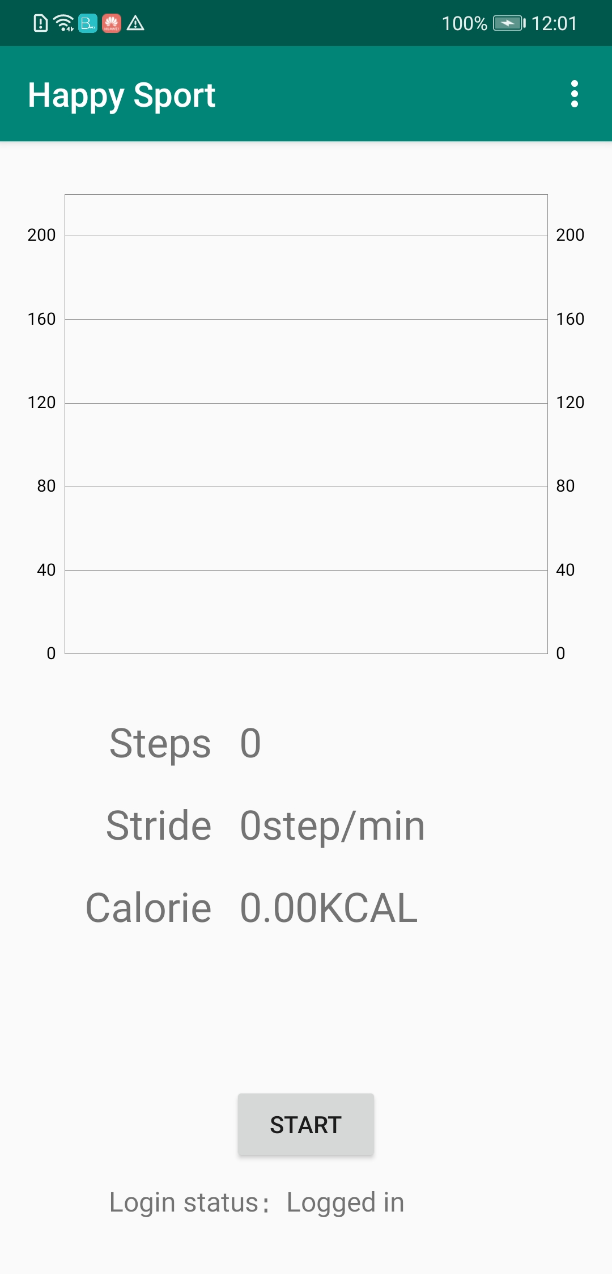
CodeLab: Obtain data to measure the step count in real time
1. Run the initial project.
Download the original framework code.
Decompress the initial project to:
D:\codelab\happysport
Use Android Studio to open the happysport project, build and generate the APK file, download the file to the phone, and view the running result. After the app is executed, the UI should display as below:
2. Add the login code.
Open the java file from the directory: app\src\main\java\com\huawei\codelab\hihealth\happysport\utils\HiHealthSetup.java. Add the login code snippet to replace TODO:login.
HuaweiIdSignInOptions signInOptions =
new HuaweiIdSignInOptions.Builder(HuaweiIdSignInOptions.DEFAULT_SIGN_IN).build();
mHuaweiSignInClient = HuaweiIdSignIn.getClient(activity.getApplicationContext(), signInOptions);
mAccount = HuaweiIdSignIn.getLastSignedInAccount(activity.getApplicationContext());
if (mAccount == null) {
Intent signInIntent = mHuaweiSignInClient.getSignInIntent();
activity.startActivityForResult(signInIntent, REQUEST_CODE_LOGIN);
}
The code implements login verification. A login window will display if the user is not yet logged in.

Slide 40
3. Requests user authorization.
Open the java file from the directory: app\src\main\java\com\huawei\codelab\hihealth\happysport\utils\HiHealthSetup.java. Add the authorization code snippet to replace TODO:authorization.
String[] maxScopes = Scopes.getMaxScopes();
Scope[] allRequiredScopes = new Scope[maxScopes.length];
for (int i = 0; i < allRequiredScopes.length; i++) {
allRequiredScopes[i] = new Scope(maxScopes[i]);
}
HuaweiIdSignIn.requestPermissions(mActivity, REQUEST_CODE_PERMISSION, mAccount, allRequiredScopes);
The code requests all authorizations. The demo would gather the set of all authorizations.

Slide 41
4. Register a listener for real-time data.
Open the java file from the directory: app\src\main\java\com\huawei\codelab\hihealth\happysport\viewmodels\HiHealthBaseAdapter\HiHealthBaseAdapter.java. Add the client instantiation code snippet to replace TODO:client.
mSensorsClient = HuaweiHiHealth.getSensorsClient(mContext, new FitnessOptions.Builder().build());
Open the java file from the directory: app\src\main\java\com\huawei\codelab\hihealth\happysport\viewmodels\HiHealthBaseAdapter\HiHealthBaseAdapter.java. Add the listener registration code to replace TODO: start.
DataSource dataSource = new DataSource.Builder()
.setDataType(DataType.TYPE_STEP_COUNT_CUMULATIVE)
.setDevice(new Device("hw", "hw", "hw", 0))
.build();
mSensorsClient.add(new SensorRequest.Builder()
.setDataType(DataType.TYPE_STEP_COUNT_CUMULATIVE)
.setDataSource(dataSource)
.build(),
mListener);
The code will fetch data from the step count sensor on the phone by setting a listener and a callback with mListener.

Slide 42
5. Read real-time data.
Open the java file from the directory: app\src\main\java\com\huawei\codelab\hihealth\happysport\viewmodels\HiHealthBaseAdapter\HiHealthBaseAdapter.java. Add the listener initialization code to replace TODO:listener and comment out the default section.
//private OnDataPointListener mListener = null;
private OnDataPointListener mListener = new OnDataPointListener() {
@Override
public void onDataPoint(DataPoint dataPoint) {
Log.d(TAG, "on data point received");
processDataPoint(this, dataPoint);
}
};
The real time data would be called back via the onDataPoint method.
6. Unregister the listener.
Open the java file from the directory: app\src\main\java\com\huawei\codelab\hihealth\happysport\viewmodels\HiHealthBaseAdapter\HiHealthBaseAdapter.java. Add the listener unregistration code to replace TODO:stop.
mSensorsClient.remove(mListener);

Slide 43
Try the implementation on a phone:
Build and generate an APK file, and install it on a phone.
Open the happysport app you have just installed.
A login window would show up when running for the first time. Touch to authorize permissions and log in to the app.
The HiHealthKit authorization window would show up when running for the first time. Touch Authorize.
Touch the Start button to read the data of the real-time step count.
Shake your phone to generate step count data.
The real-time step count curve, step frequency, total number of steps, and calories burnt are displayed on the UI.
Touch the Stop button to stop the reading.

Slide 44
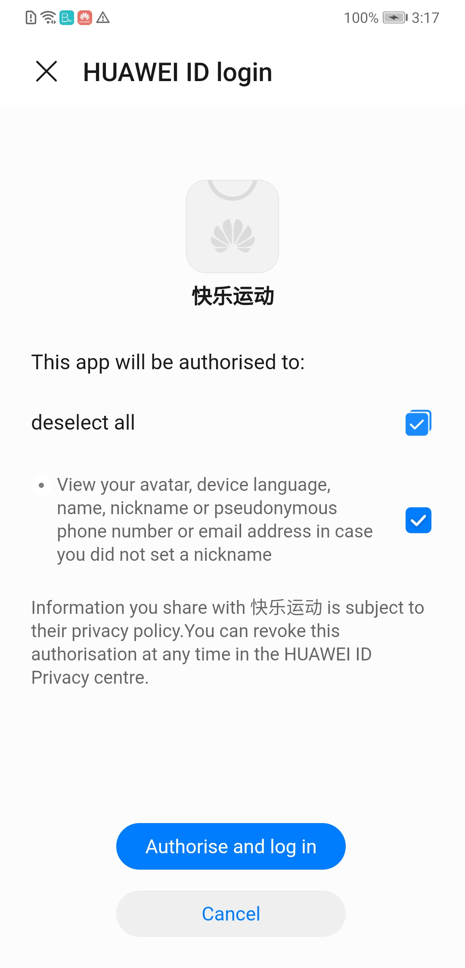
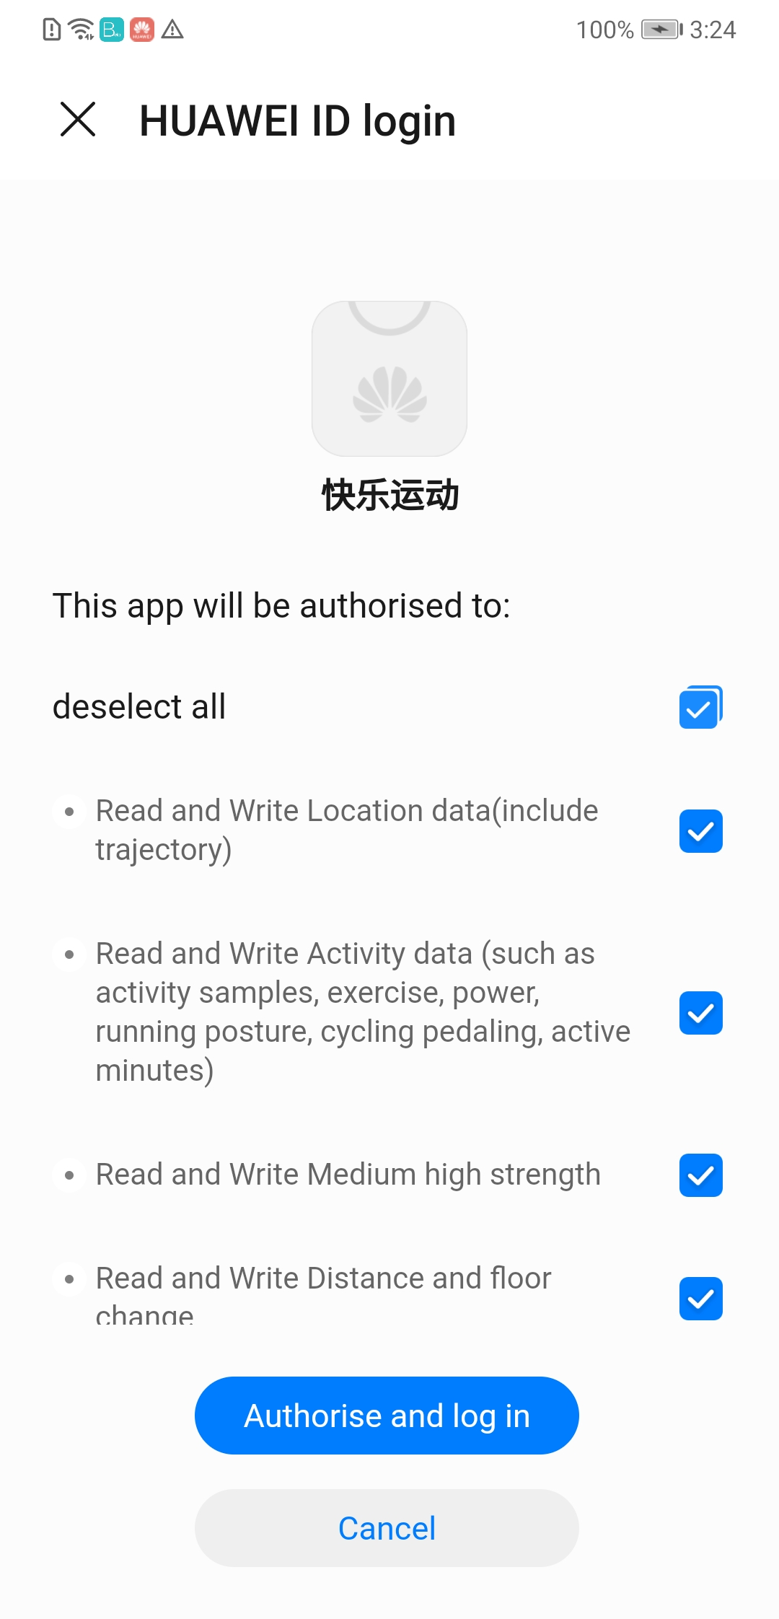
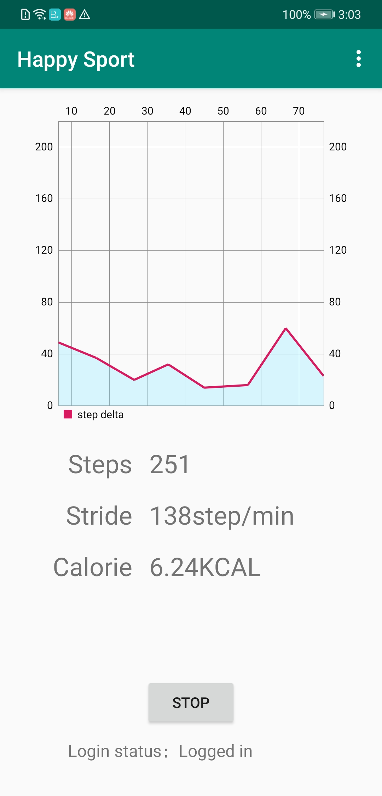

Slide 45
Thank You!

Slide 46
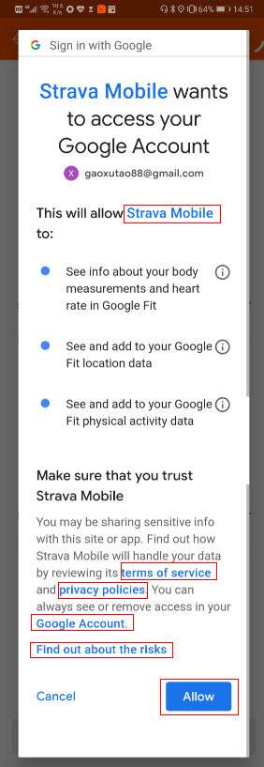
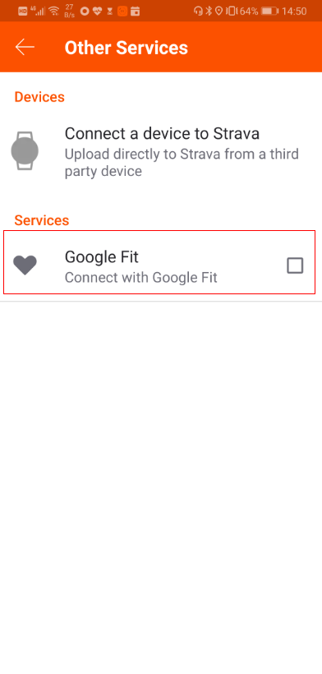
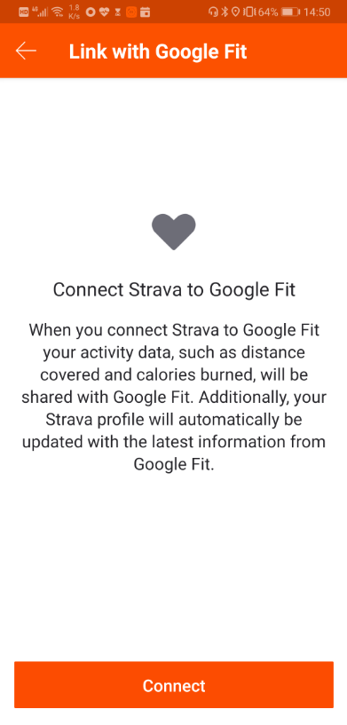
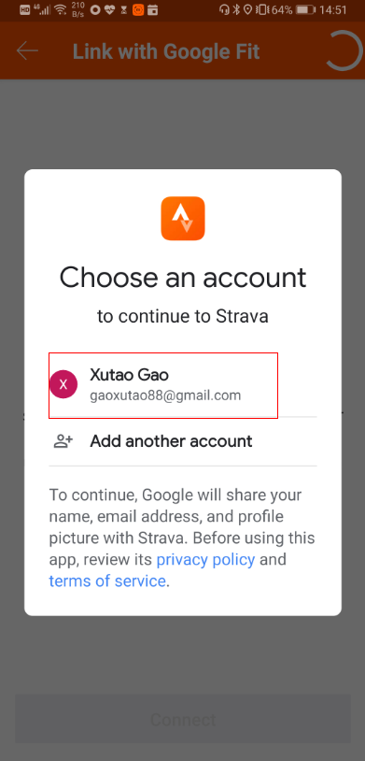
Google fit authorization flow in 3rd apps
Authorization flow in 3rd Strava app
Email link
description of the data type
Link in 3rd site
Link of login page
Describe how 3rd party sites & apps access to google account

Slide 47
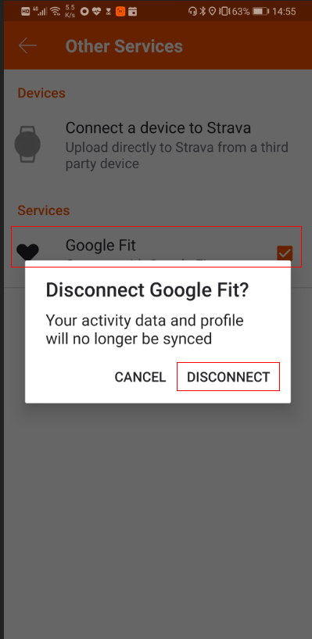
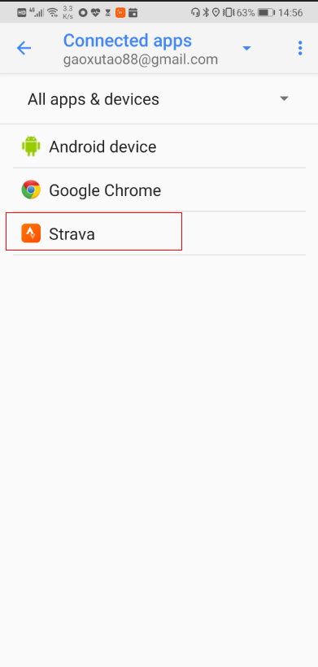
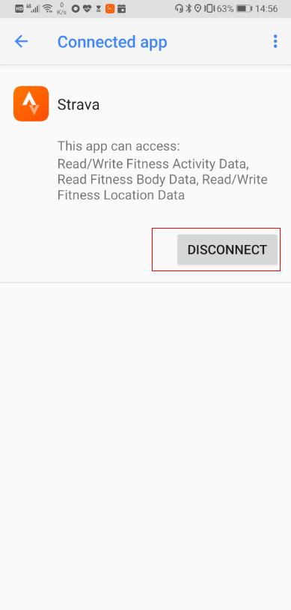
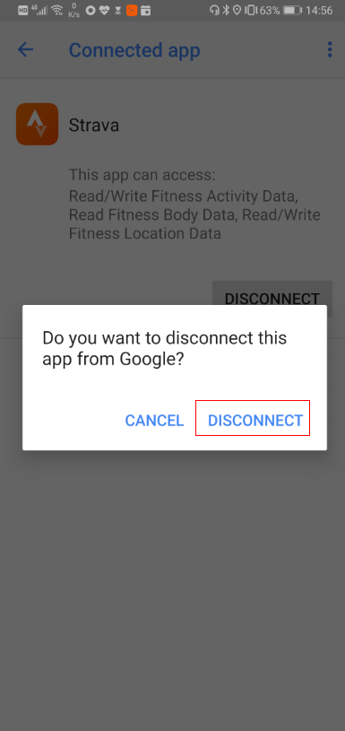
Google fit revoke the authorization in 3rd apps and Google account services
Disconnect in 3rd Apps
Disconnect in Setting - Google - Account Services – Connected apps

